Slide 1
The multi-demand networks contribute to math academic performance
Team members: Tongxi YANG, Yixuan SUN, Rui GUO

Slide 2
01.
Introduction
CONTENTS
02.
Methods and Results
03.
Discussion

Slide 3
01.
Introduction

Slide 4
Question:

Slide 5
Literature review

Slide 6
Data introduction

Slide 7
02.
Methods and Results

Slide 8
Overall Workflow
1. Data Preprocessing
2. ROI extraction
3. FC calculation
4. Model
Start
CPM
Ruiguo
yixuansun
fMRIPrep21.4.1
For each participant, calculate Pearson correlation between regions for 4 tasks
Regress 24 columns of head motion regression
Time-align and image deformation
R square
MSE
Use Shen 268 template to extract the average BOLD signal of all voxels in the regions of interest (ROI)
standardized to the standard spatial template
End
Process noise with ICA-AROMA

Slide 9
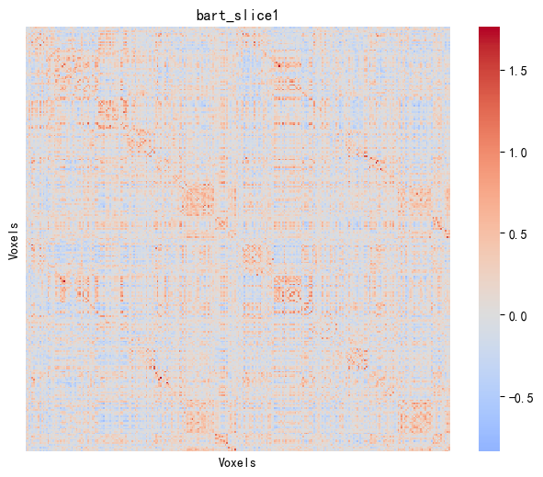
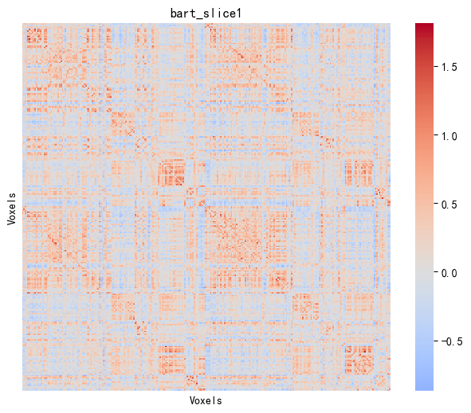
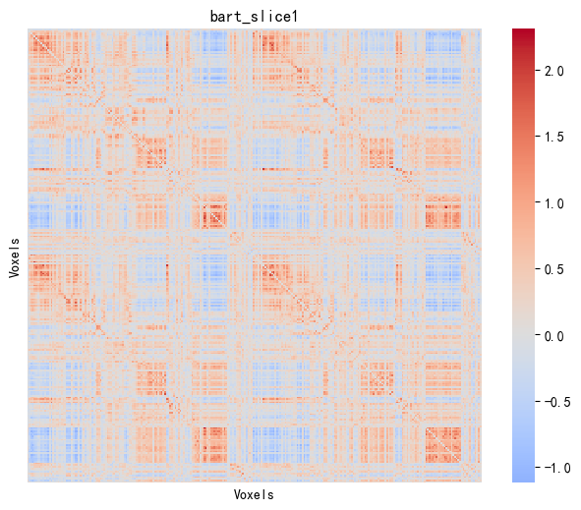
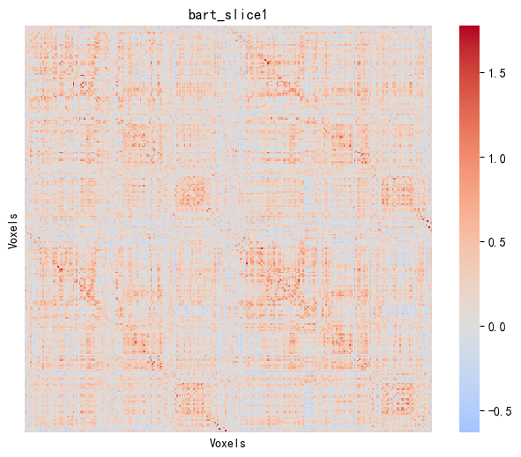
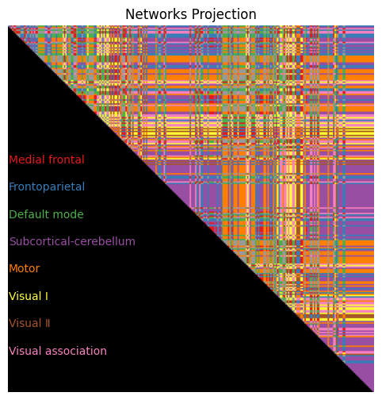
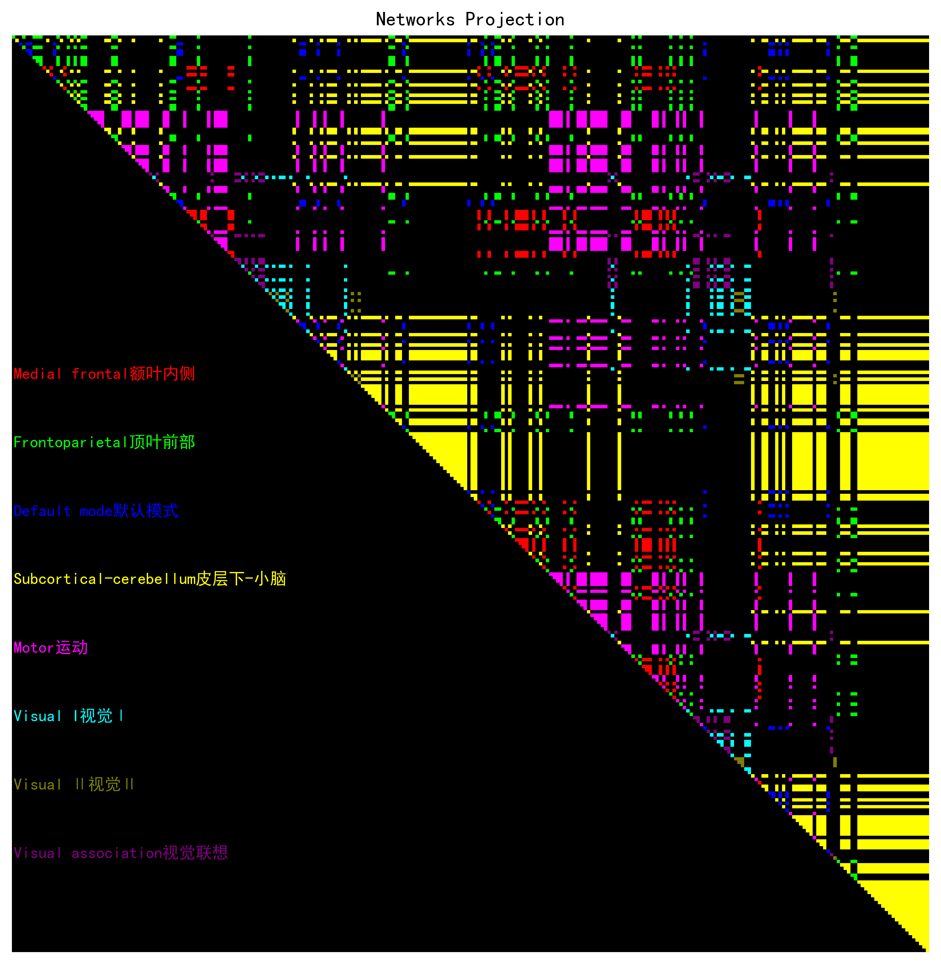
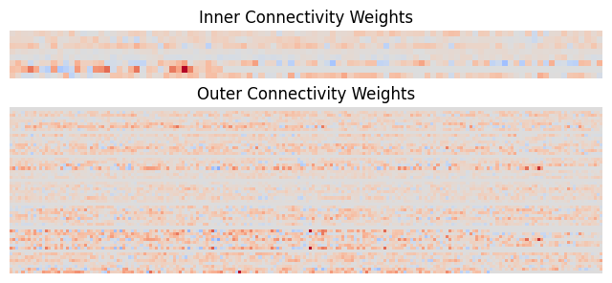
CPM: GAT Model
FC Matrices
Tasks
Merging instances to improve data diversity
Avoid interference between features of different brain regions
N-back Task
...
Merge all instances of four tasks and then standardize on merged data
(1171 instances in total)
Split the node connectivity features within each brain region into 8 sub-feature sets
Split the node connectivity features between each pair of brain regions into 56 sub-feature sets (including connections in both directions)
This results in a total of 64 sub-feature sets of functional brain connectivities
Attention Network Test
...
Balloon Analogue Risk Task
...
Emotion Face Matching Task
...
Inner&Outer Connectivity Groups
Train PLS on each sub-feature set and obtain the weight of each node feature
A try
Use a meta-model as an elastic regression network stacking model, training the model with the outputs of all PLS models as inputs. However, the performance is poor
(specifically, the R² is only 0.16)
Weight the data and construct the training and test sets with a ratio of 0.85 : 0.15
How can we better utilize latent features?
GAT Model

Slide 10
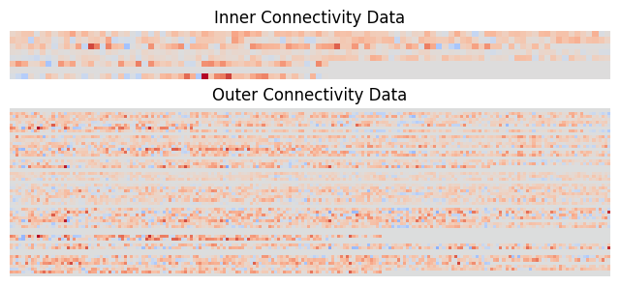
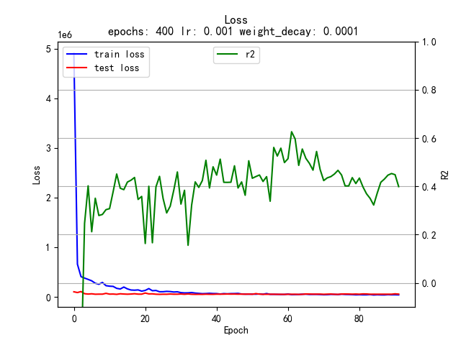
CPM: GAT Model
Idea:
GAT Model.
Treat each brain region as a node in the GAT, with intra-region connectivity features as node features.
Treat the connections between each pair of brain regions as edges, with inter-region connectivity features as edge features in the GAT.
Weighted train&test datasets
Graph Attention Network
Train GAT model and plot the loss curve and R² curve
Node Features
Edge Features
Input
Hyperparameters
Epochs | 70
Batch_size | 32
Optimizer | lr | 0.001
 | weight_decay | 1e-4
 | lr_scheduler | mode | min
 |  | factor | 0.5
 |  | patience | 20
Metrics | R² & MSE
Early_stop | 70
Features Mask
heads=8
dropout=0.5
concat=True
negative_slope=0.2
add_self_loops=True
bias=True
residual=True
GAT Conv
×6
GAT Conv
GAT Output
×1
heads=1
dropout=0.2
concat=False
negative_slope=0.2
add_self_loops=True
bias=True
residual=True
Extract the top 10% important features and find their corresponding networks using the Features Mask
Average pooling
Output

Slide 11
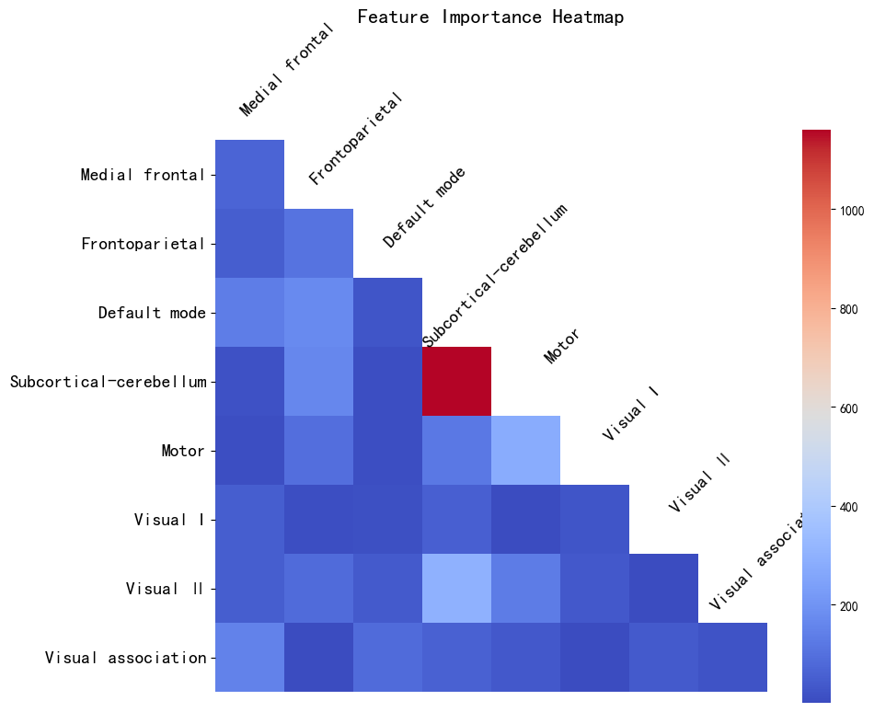
Networks associated with math performance
Model | Task | Description | R-square | MSE
Lm1 | N-back task | Working memory | 0.0270 | 10039.25
 | Attention Network Test | Attention ability | 0.0203 | 10045.28
 | Balloon Analogue Risk Task | Risk decision-making | 0.0199 | 10170.10
 | Emotion Face Matching task | Emotion recognition | 0.0047 | 10233.37
Lm2 | N-back task *** | Working memory | 0.4944 | 5237.01
 | Attention Network Test *** | Attention ability | 0.4826 | 5248.34
 | Balloon Analogue Risk Task *** | Risk decision-making | 0.4941 | 5269.26
 | Emotion Face Matching task** | Emotion recognition | 0.4178 | 6008.52
GAT | Merged Tasks | Merged Tasks Data | 0.6529 | 4461.43
Result
Networks associated with math academic performance are primarily located in the multiple-demand system. These networks are mainly allocated to the cerebellum and secondarily to the connectivity between the cerebellum and Visual II.

Slide 12
03.
Discussion

Slide 13
Limitations

Slide 14
Future work

